Slide 1



Cyber Kill Chain
Eng. Mahmoud Hassan

Slide 2
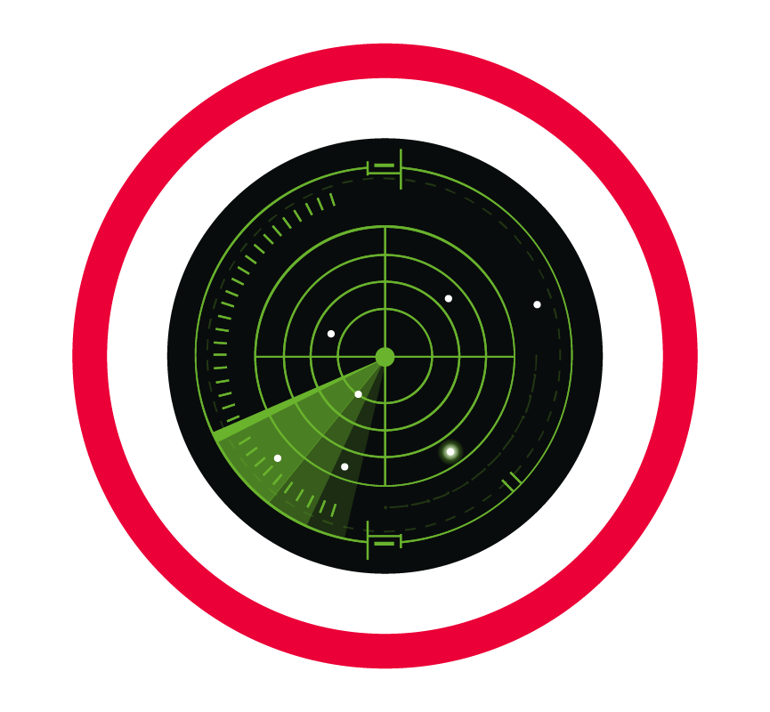
Reconnaissance
Reconnaissance from the Attacker's Perspective:
Reconnaissance is the first phase where an attacker begins gathering information about the target system or victim. This phase is essentially the planning stage of an attack, where the attacker aims to fully understand the target before taking any action.
Reconnaissance Types
Passive Reconnaissance
Active Reconnaissance
The attacker interacts directly with the target system, increasing the risk of detection
The attacker gathers information without directly interacting with the target
WHOIS Lookup – To find domain registration details.
Google Dorking – Using advanced Google searches to find sensitive data.
Ping Sweeps – Checking if hosts are alive.
Port Scanning – Using tools like Nmap to find open ports.
OS Fingerprinting – Identifying the operating system used by a target.

Slide 3
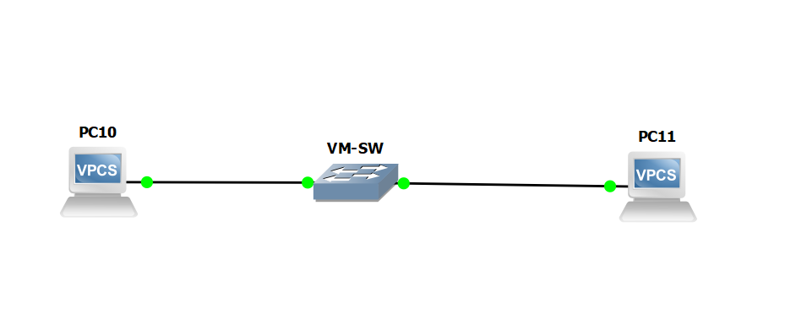


Kali Linux VM
Metasploitable VM
VM SW

Slide 4



Thank you
+201116735630
mahmoudhassan2947@gmail.com
www.linkedin.com/in/mahmoud-hassan-b4400b1b7

